Slide 1
Airbnb Pricing Analytics
Notes:
Hello everyone, our group is going to talk about our pricing analytics case on Airbnb.

Slide 2
Content:
Background and pricing problems
Proposed pricing solution
Optimal pricing strategy
Evaluation of other strategies and further improvements
Notes:
Our presentation will include 4 parts. Background, proposed solution, optimal strategy and evaluation.

Slide 3
01
Background and pricing problems
Notes:
Now, let’s go to the part 1.

Slide 4

Backgrounds - Vacation Rental Industry
Current Pricing (@ travellers):
Fixed pricing based on:
Cost-plus: equipment cost, cleaning fee...
Value: location,convenience...
Competitors:
HomeAway,Vrbo, Booking, Expedia, Agoda etc.
Customer:
Travellers (our target in this case)
Hosts
Market:
Occupied 17.7% market
Ranked No.3 (after Booking and Expedia)
*2019 Statistics (before covid): https://www.businessofapps.com/data/airbnb-statistics/
Notes:
Airbnb is known as a short-term vacation rental platform. In this field, it has various competitors such as homeaway, vrbo, booking, expdia and agoda. As an intermediary, airbnb’s customers include travellers and hosts. In this case, we will focus on the traveller as our pricing target.
Currently, based on our data, most hosts on the platform decide their prices on a fixed basis. The fixed price is based on host’s subjective value on the properties plus the cost. The cost include equipment cost, cleaning fee and commission to airbnb. Value reflects the location and convenience of the properties.
As for the current market, statistics before covid in 2019 shows that airbnb is the no.3 vacation rental platform occupying 17.7% market share, after booking and Expedia. It’s a fierce competition to airbnb.

Slide 5
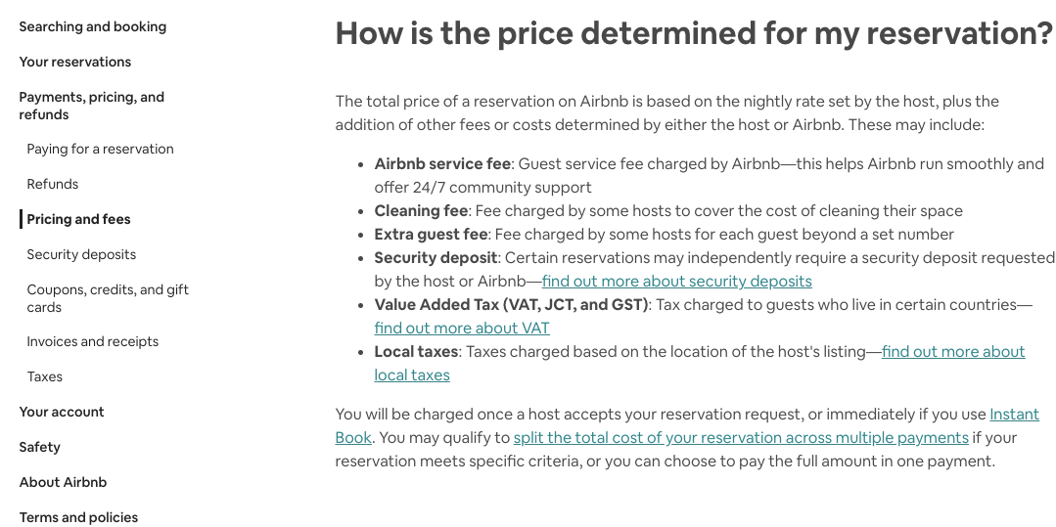
Backgrounds - Pricing and Cost
Source: Airbnb.comhttps://www.airbnb.com/help
Notes:
Focus on pricing, in this slide, we can see the screenshot of basic pricing rule for the properties on airbnb website.

Slide 6
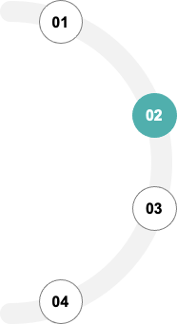
Pricing Issues
Target customers, who choose vacation rental, tend to be price sensitive. (compared to hotel customers)
The pricing is nearly fixed.
The prices are set by hosts and can’t reflect the true WTP.
The pricing can’t achieve the maximum profits.
Notes:
Next, we can find some pricing issue that airbnb is facing,.
1.compared to hotel customers, airbnb’s target customers, who choose vacation rental, tend to be price sensitive.
2. Based on the data, airbnb is almost fixed.
3. From above screenshot and analysis, we know that the prices are set by hosts and can’t reflect the true Wiling to pay.
4. Therefore, the final issue is that hosts can not achieve their maximum profits through this pricing method.

Slide 7
02
Proposed pricing solution
Notes:
In part 2, we briefly propose a pricing solution to current dilemma.

Slide 8
Overview of Our Solutions -- Maximize Profit
Properties with different attributes tend to have different demand and prices. Therefore, we need to cluster the properties to different groups based on their attributes and analyze the price respectively.
Better to solve Causal Inference between Price and Demands.
Clustering
Find the demand
We need to find a way to effectively project demand of each property given a set of predetermined parameters.
Predict the price
We need to find a way to effectively project price of each property given a set of predetermined parameters. ( Random Forest)
Calculate the profits
We will use the projected demands and price, and variable costs to calculate the profits. Find the optimal price with maximum profit.
Notes:
Here, our goal is to maximize the profit.
In a pricing case, we need to balance demand and price, which have causal inference between them two. Differences in attributes may lead to different price sensitivity. Thus, we suggest to cluster the properties to different groups based on their attributes and analyze them respectively.
Then, we use another independent model to predict demand and corresponding price. Next, we will use the projected demands and price, and variable costs to calculate the profits. So we can fiind the optimal price with maximum profit.

Slide 9
Overview of Our Solutions
Main drivers of pricing
Using feature importance analysis, we can get the top 3 main drivers of pricing in each cluster.
The nearby neighborhood can be regarded as the competitor for a specific property. When we decide the price, we should consider the influence from these competitors
Competitor effect
Notes:
Also, we are going to find key drivers of the pricing to help us interpret and understand the pricing.
Besides, The nearby neighborhood can be regarded as the competitors for a specific property. When we decide the price, we should consider the influence from these competitors
Next, Ying will give further talk on the strategy.

Slide 10
03
Optimal pricing strategy
Notes:
Here comes the optimal pricing strategy we designed for airbnb

Slide 11
Data Description
Price | Demand | Influential components (28 components)
price | Reviews_per_month | accommodates, host_response_time,Bathrooms, bedrooms, beds, security_deposit, cleaning_fee, extra_people, minimum_nights, maximum_nights, guests_included, availability_365, number_of_reviews, review_scores_rating,review_scores_cleanliness, review_scores_checkin, review_scores_communication, review_scores_location, review_scores_value, House_rules, amenities, bed_type, room_type, cancellation_policy, property_type
Notes:
We found the data from a github repository about airbnb dynamic pricing strategy. The data is quite complete including many useful information, such as the price for each property, the reviews_per_month each property received and some influential components of each property

Slide 12
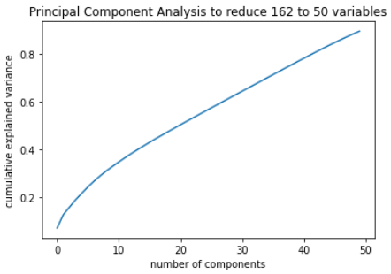
PCA
Principal Component Analysis to reduce 162 variables to 50 variables, explaining more than 90% of the variance
Notes:
After transforming the data type to what we can use to train model, we got 162 variables, very large. Therefore, we chose to use PCA to reduce the number of variables to 50 which can explaining more than 90% of the variance and can get rid of the issue of correlation between variables.

Slide 13
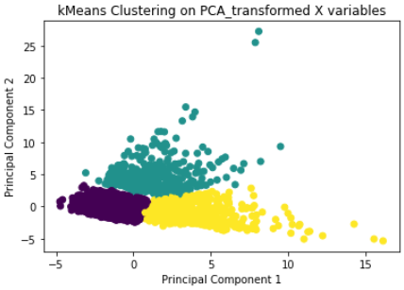
Clustering
K Means Clustering on PCA_transformed X variables
Notes:
Based on the PCA transformed variables, we clustered the properties to 3 clusters using K means. This ensured that the clusters were from properties as similar as possible.

Slide 14
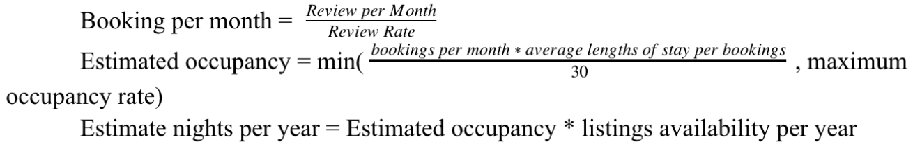
Demand --- Estimated Occupancy Rate
Facts:
The average length of stay per guest is 4.2 nights
Assumptions:
We assume each property has 4.2 days as an average lengths of stay per booking
We assume the review rate to be 0.5
We assume the maximum occupancy rate is 0.95
Notes:
Before finding the optimal price, we need to first find out the demand for each property. We collected some facts and put forwarded some assumptions. As found in the Overview of the Airbnb Community in San Francisco published by Airbnb, the average length of stay per guest is 4.2 nights. We assumed each listing has 4.2 days as an average lengths of stay per booking. Since we were not able to find a clear number for the ratio of guests making a booking who leave a review for Airbnb, we assumed the review rate to be equal to 0.5, which will be used as a constant throughout the estimation. To prevent artificially high results, we also assumed the maximum occupancy rate cannot exceed 0.95, meaning even the busiest properties will have several nights a month in which they go unrented. With these assumptions and constants, we generated the formulation of estimated occupancy rate shown below:
Dividing the review per month over review rate, we can get the booking per month. Next multiplying booking per month by 4.2 and divided by 30, we can get a rate. Then compare the rate with the maximum occupancy rate and get the minimum value. This value is our estimated occupancy, namely the demand.

Slide 15
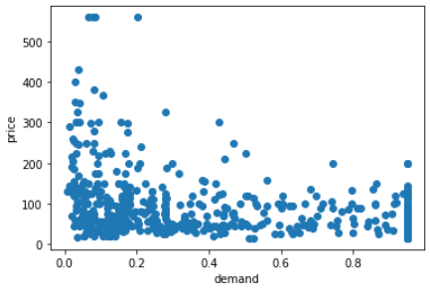
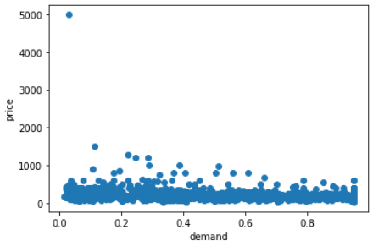
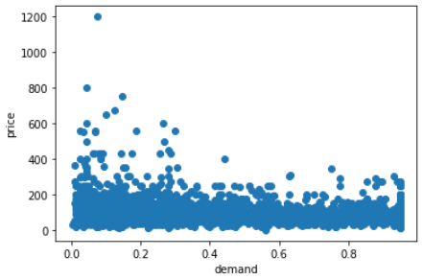
Relation between Price and Demand
Cluster 1
Cluster 2
Cluster 3
Notes:
Now we have 3 clusters and their corresponding price and demand. With the data, we can draw the scatter plots for each cluster to find the relationship between price and demand. From the three graphs, we can see that cluster 1 is more sensitive to price. With price going up, the demand will decrease. Cluster 3 also shows this trend, but not as obvious as cluster 1. For cluster 2, the price is quite fixed and the demand is hardly influenced by the price.

Slide 16
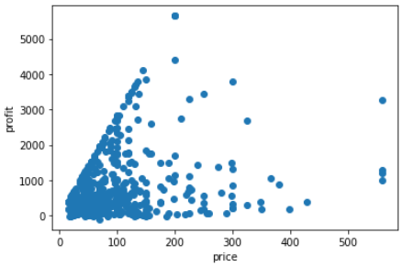
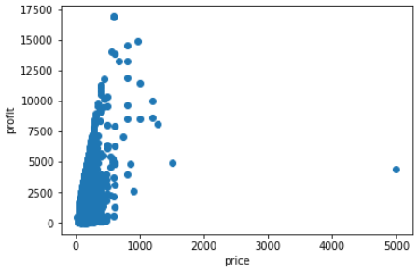
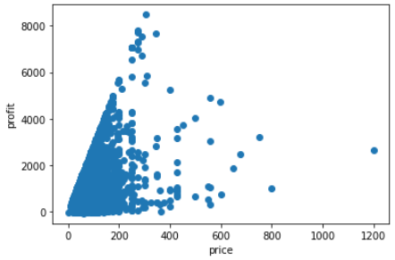
Optimal Price & Maximum Profit
Cluster 1
Cluster 2
Cluster 3
Priced @ around $200
Priced @ around $800
Priced @ around $300
Notes:
The original dataset also contains the variable cost for each property, then we can calculate the revenue and profit, and get the scatter plot with price as x axis and profit as y axis. For cluster 1, the optimal price to achieve maximum profit is around 200. Cluster is around 800 and cluster 3 around 300.

Slide 17
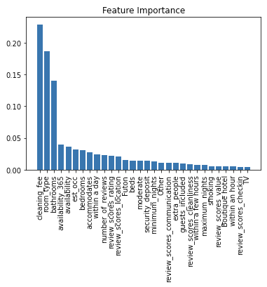
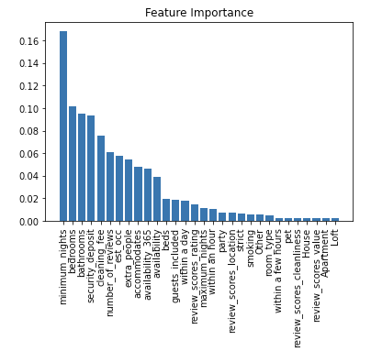
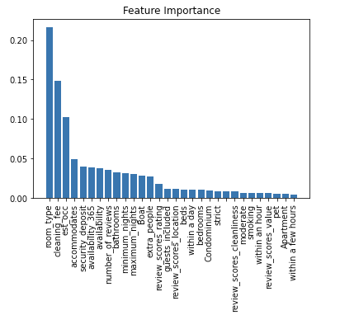
Main drivers -- Feature Importance (Top 3 drivers)
Cluster 1
Cluster 2
Cluster 3
Cleaning fee
Room_type
Bathrooms
Minimum nights
Bedrooms
Bathrooms
Room_type
Cleaning_fee
Estimated_occupancy rate
Notes:
Within each cluster, we used Random Forest Classifier to train the model with price being dependent variable and other variables indicating the attributes of properties as independent variables. Then with feature importance analysis, we can get the top 3 main drivers of pricing in each cluster.
Cleaning_fee, room_type and bathrooms are the most important drivers for the price of properties in cluster 1
For cluster 2, minimum nights, bedrooms and bathrooms are important
For cluster 3, Room_type, cleaning fee and estimated occupancy rate are important.

Slide 18
04
Evaluation of other strategies and further improvements
Notes:
Finally, I will talk about the competing strategies that we have considered, and why we decided on our chosen strategy

Slide 19
Evaluation of other Strategies
Pros
Cons
Cost-plus pricing
Doesn’t require a lot of market research
Doesn’t take into account consumers and competitors
Competitive pricing
Prevent business from losing market share to a competitor
Pricing products too low can hurt profit if the revenue doesn’t cover costs
Notes:
First strategy that we considered was the cost-plus pricing strategy, which, as we introduced in the first part of the presentation, is the industry norm right now, where price is set first based on basic conditions, with the values of extra furnitures and service fees and taxes are added on top of that. While this approach does not require a lot of market research for the hosts and the platform, meaning lower cost for us, it tends to lead to unwise pricing decisions because it fails to take into account the consumers and the competitors, including the general demand and willingness to pay, which our method does a better job of.
We also considered competitive pricing, which protects our own market share, but could put us in a situation where we either have to price above our competitors and lose potential customers, or the price so low that we can’t even cover our own costs. In comparison, our strategy is better in the sense that it provides a full analysis on the main drivers of different types of accommodations, so each listing could seek to grow in the area that it has the most competitive advantage, and grow in values and pricing so that it doesn’t get into a situation where it becomes a vicious price war for everyone in the industry

Slide 20
Evaluation of other Strategies
Discriminated pricing:
Based on the optimal pricing strategy, price discrimination can be conducted according to the frequency (honesty) of customers renting etc.
Pros
Cons
More flexible and able to achieve more profits
May hurt some customer’s feeling, and Airbnb isn’t monopoly so difficult to conduct maximum-profit dicscrimination pricing
Notes:
Alternatively, we considered making pricing discriminative, and that gives both the platform and the hosts more flexibility for maximizing profits by making relevant pricing strategies. The downside is that consumers will likely communicate with each other and know that we are offering different customers different prices, which could damage the brand and cause losing customers to competitor brands. Instead, our strategy is focused on differentiation of the basic conditions of the listings based on variables such as area and amenities values, or objective measures like cleanness, rather than differentiating the customers, which is less likely to hurt consumers’ feelings and causing them to churn.

Slide 21
Limitation and improvements
Limitation:
Not consider the time series effects, so not time sensitive.
Only consider maximizing the profits, ignoring the promotion and competitive strategies
Improvements:
Repeat running the models in different periods/seasons to get different optimal price in time series.
Considering a coherent strategy based on properties’ conditions: eg. lower pricer for promotion
Notes:
While we were glad to have picked a strategy that beats the other ones, we have also identified some limitations of our strategy. First of all, we did not consider any seasonal effects due to the lack of data availability. We also lacked tools to consider geographical variables, which could be influential because farther away competitions are not as threatening as the ones in nearby areas. Also due to limitation on available data, we did not consider competitive strategies, particularly ones that have to do with competing platforms in the same market, or any effects that any current promotions is offering.

Slide 22
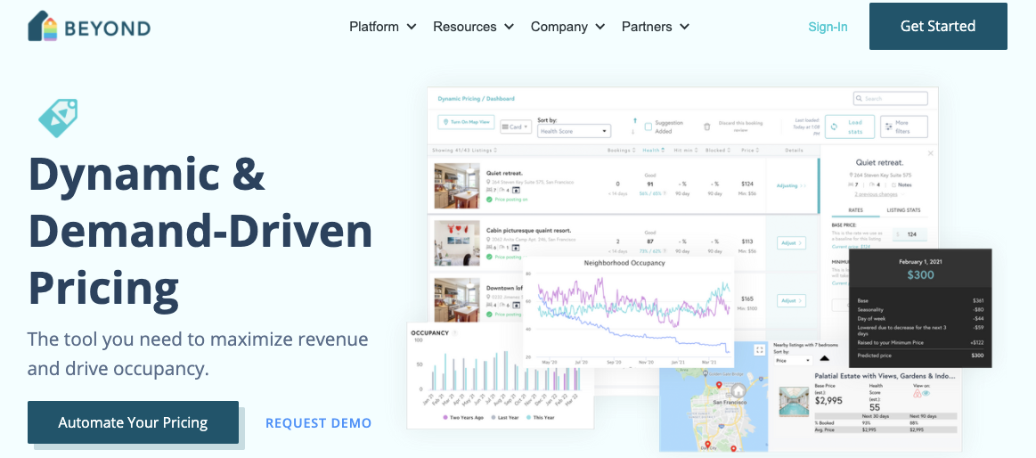
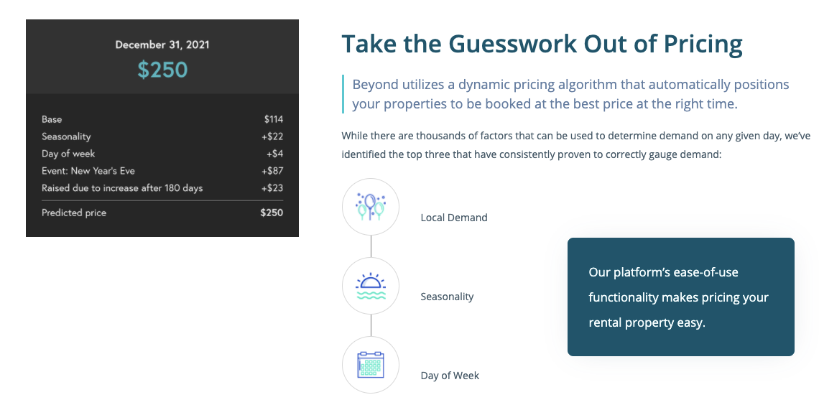
Accidental findings during the project
An Expert Website (BEYOND) is providing better and more specific pricing service for short-term rental managers and owners.
Notes:
Finally, we want to share a surprise finding in our research of the vocational rental industry, which is that this website called BEYOND is an additional resource for pricing decision making services specifically designed to help short-term rental managers and owners. This proves there has been people who understand the lack of pricing tools for hosts and have developed business model to fill the gap in the industry. Perhaps very soon, a more comprehensive pricing model will be widely available to all stakeholders who wish to join the industry

Slide 23
Thank you!
Notes:
This concludes our presentation. Thank you for listening

